Slide 1
Thresholds, risks and realities – lessons from the past to inform the future?
BCPC Pests & Beneficials Review , 29 January 2020
Dr Bill Parker
Head of Technical Programmes
AHDB

Slide 2
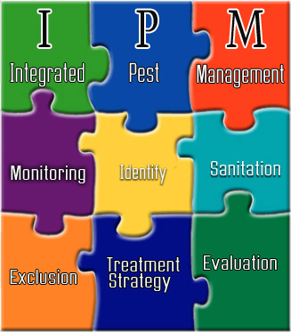
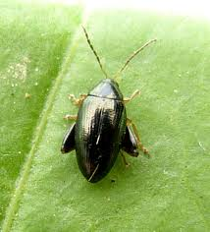
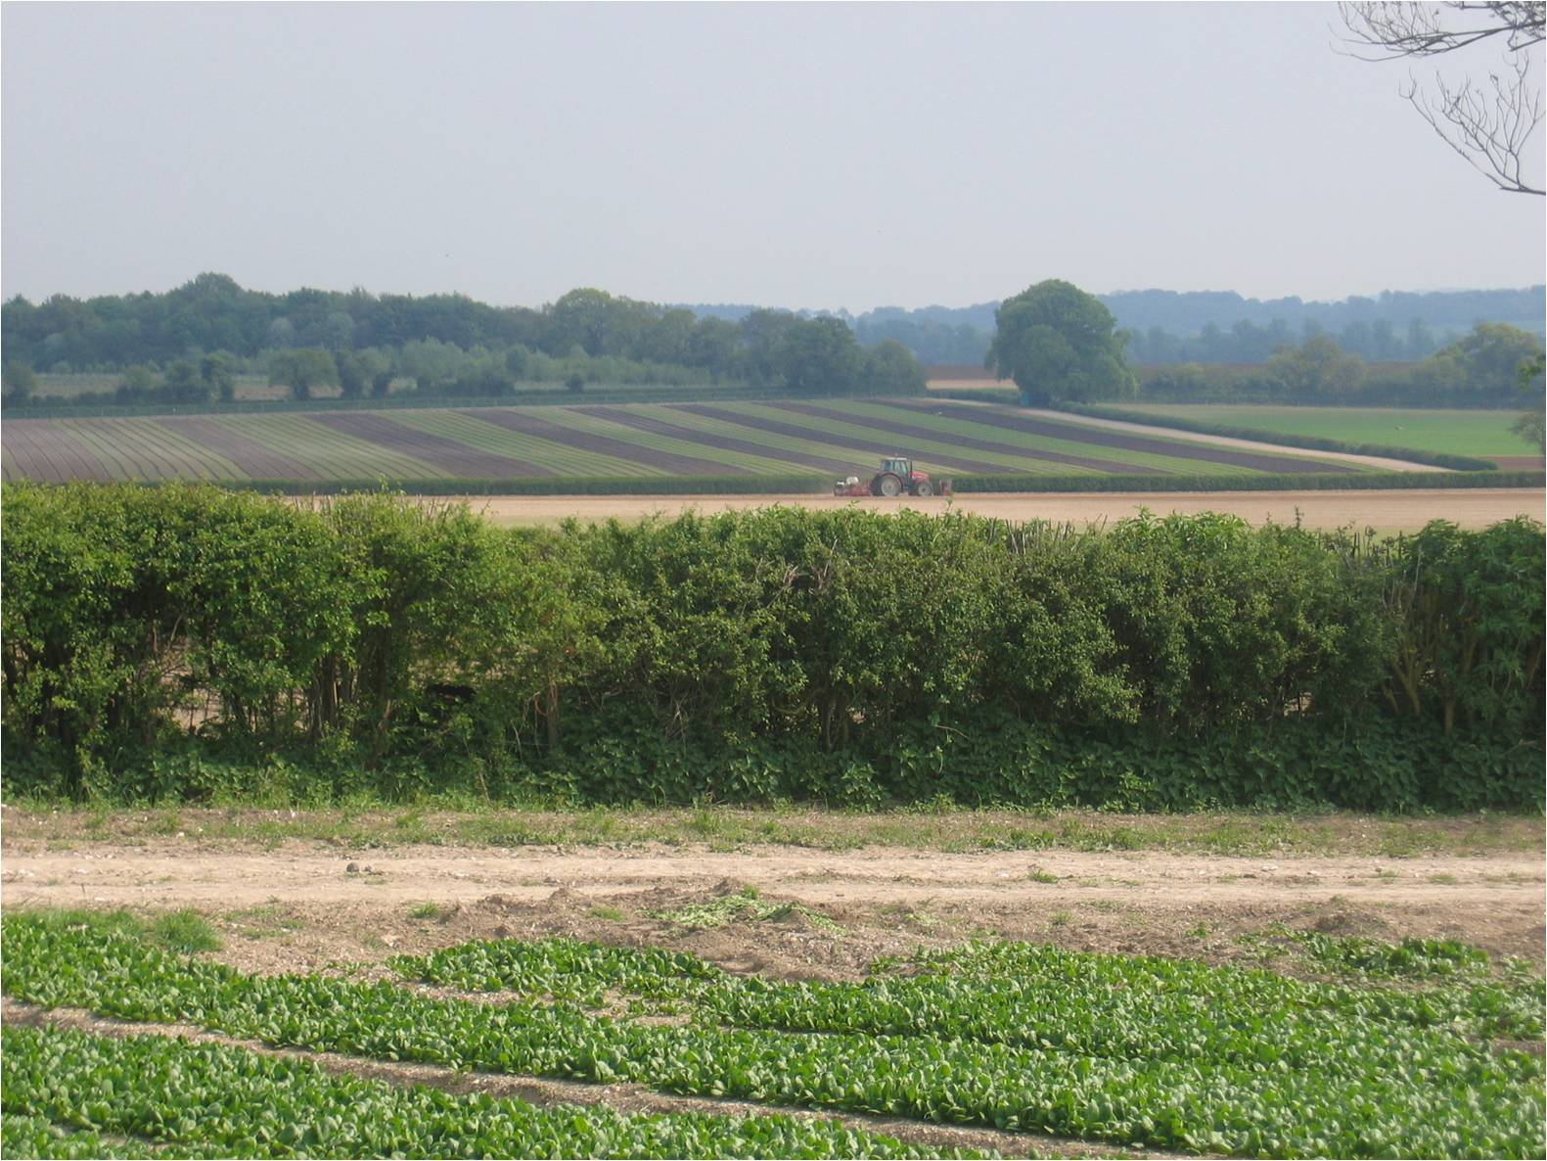
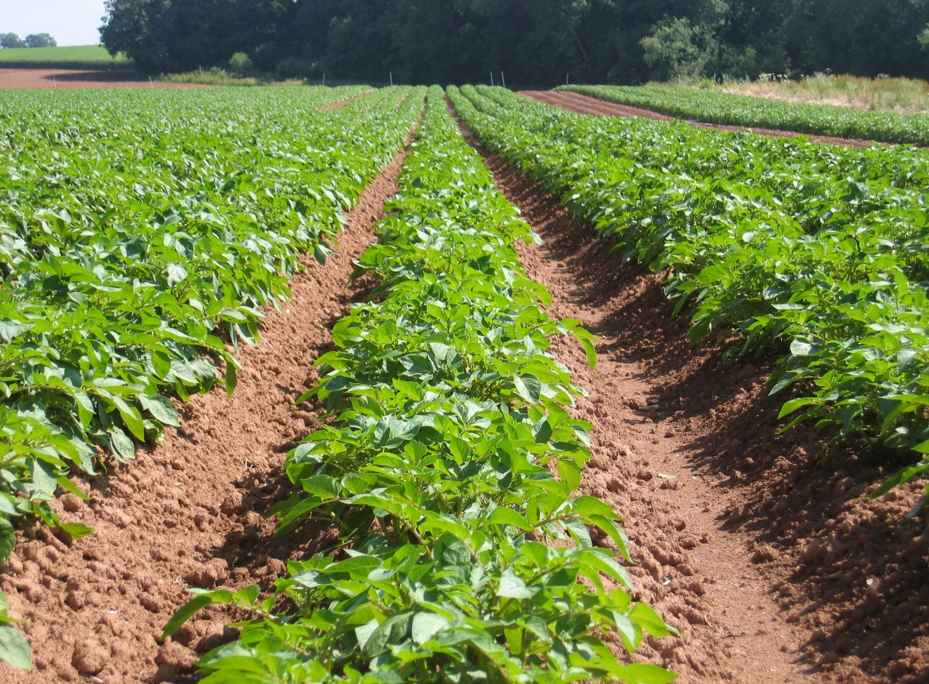
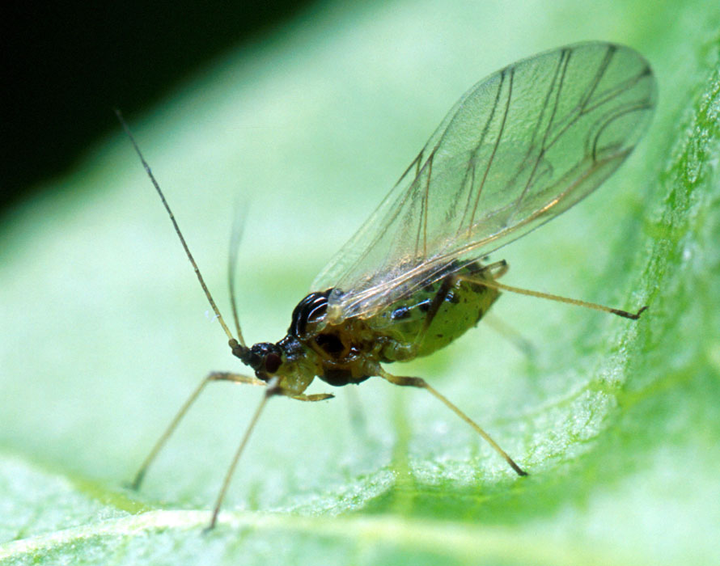
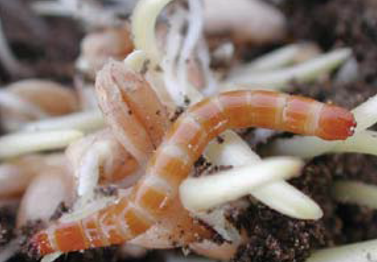
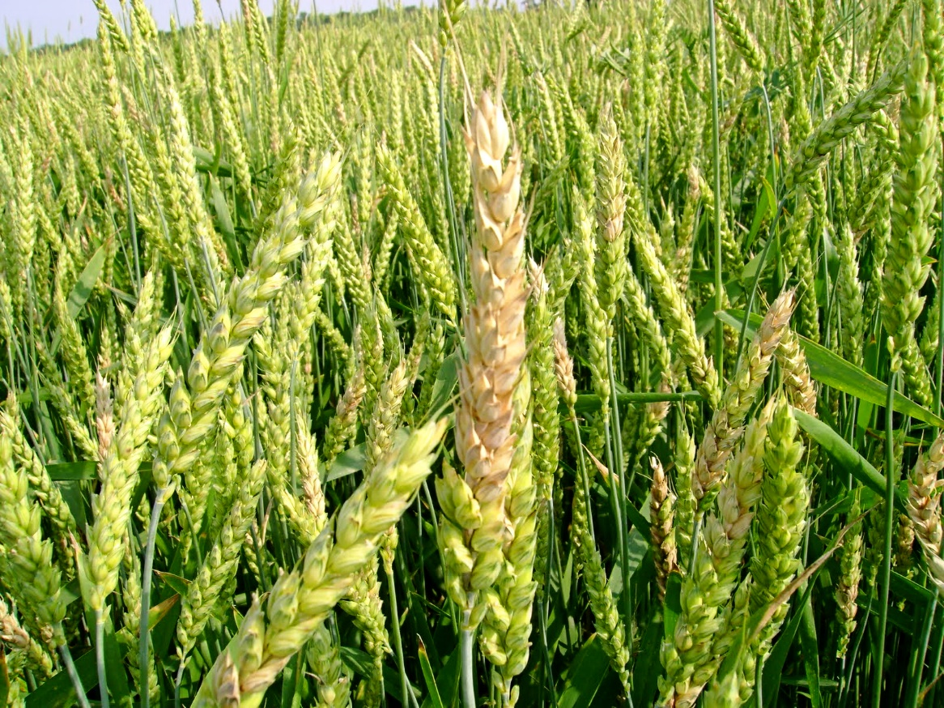

Slide 3

Where are we with IPM implementation?
To carry out research on pest management methods is one thing, to get the results applied in the field by commercial growers is quite another.
  Just doing the research is not enough
This is illustrated by the relatively low number of pest management methods actually used by growers in their regular cropping practice when compared with the number of pest management methods which are potentially useful.
  Much research has been done, relatively little of it has been applied in practice.
This was 1985
J Theunissen & H van Ouden, 1985. Progress on Pest Management in Field Vegetables. Edited by R. Cavallo.

Slide 4
Can we measure if we have moved on?
2000: Finch & Collier – QUALITATIVE?
Improvements in insecticide application, supervised control, and pest forecasting systems have helped to reduce the amount of insecticides required to control vegetable pests.
By growing plants that are partially resistant to certain major pests, it is now possible to apply even less insecticide than the dose recommended for the crop.
In crops where only small amounts of insecticides are applied, natural predators should prevent large increases in pest insect populations.
Finch, S & Collier, R 2000. Integrated pest management in field vegetable crops in northern Europe – with focus on two key pests. Crop Protection 19: 817-824
2019: Creissen et al. - QUANTITATIVE
A significant deficit exists in the ability to practically monitor and measure IPM adoption across arable farms.
Established a universal metric for quantifying adoption of IPM in temperate arable farming.
Survey results: all farmers had adopted IPM to some extent (mean score of 65/100), but only 13 of 225 farmers (5.8%) had adopted more than 85% of what is theoretically possible.
Creissen et al., 2019 Measuring the unmeasurable? A method to quantify adoption of integrated pest management practices in temperate arable farming systems. Pest Management Science 75: 3144-3152.

Slide 5
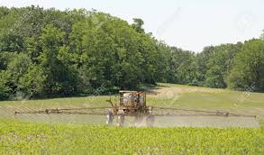
UK Insecticide usage: 1990 – 2016 (all crops)
Source: Official Pesticide Usage Survey data

Slide 6
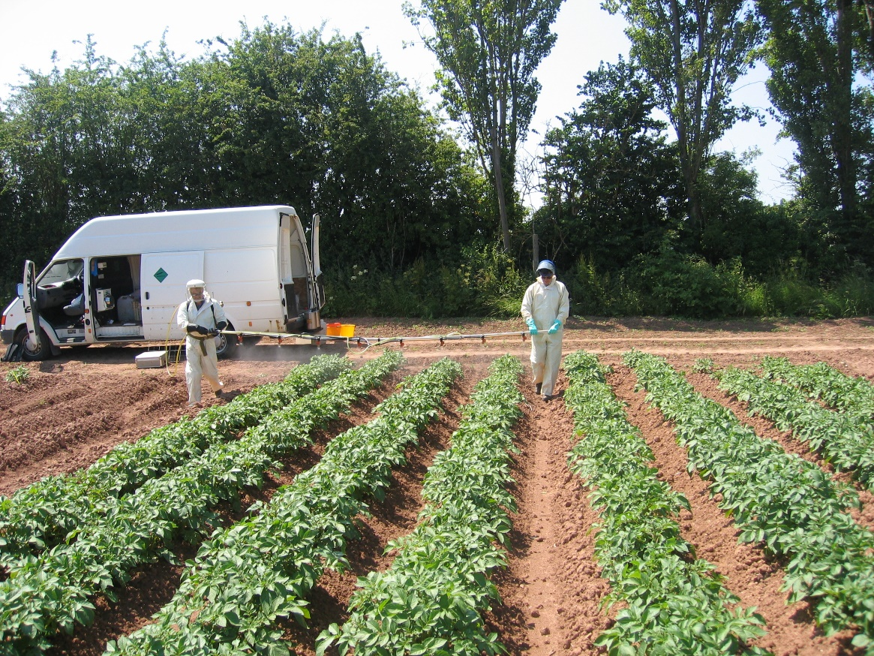
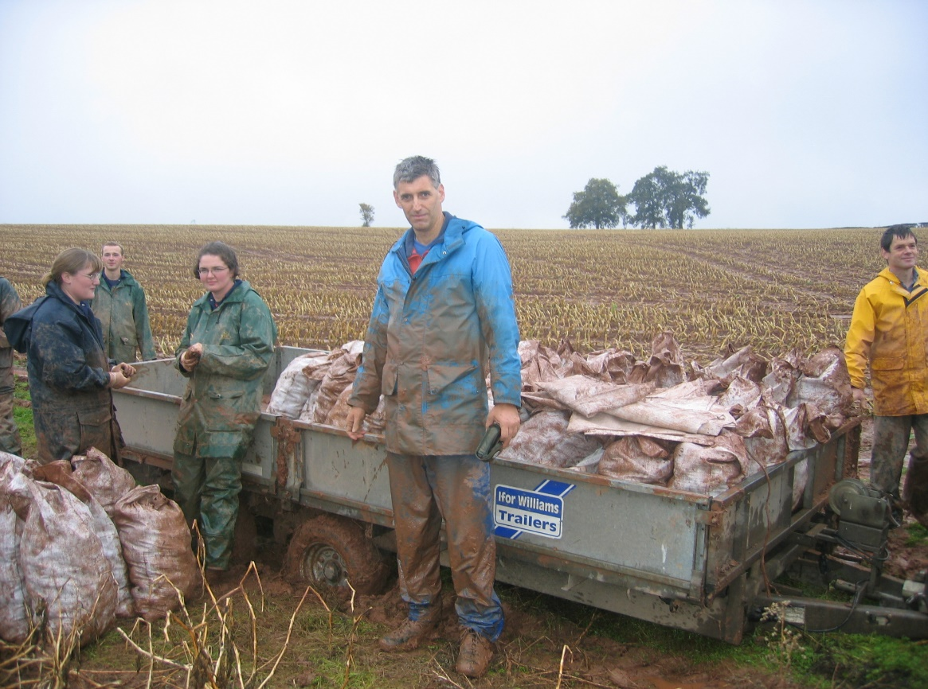
Thresholds – a key tool that needs metrics
Economic Injury Level (EIL):
  The smallest number of pests (amount of injury) that will cause yield losses equal to the pest management costs.
Economic (action) threshold (ET):
  The pest density at which management action should be taken to prevent an increasing pest population from reaching the EIL.
Establishing an ET is hard work:
  It incorporates the EIL.
  Need to understand pest population dynamics & relationship with yield loss & crop phenology in the specific crop.
  Practical aspects of management tactics all have to be considered when establishing ETs

Slide 7
Threshold concepts in practice
Economic (action) Threshold

Slide 8
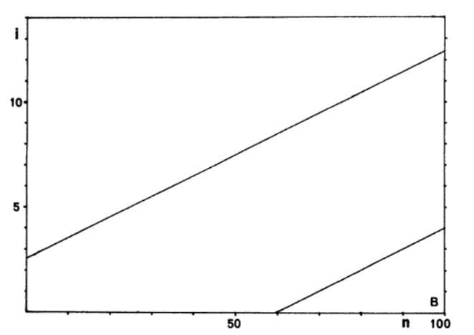
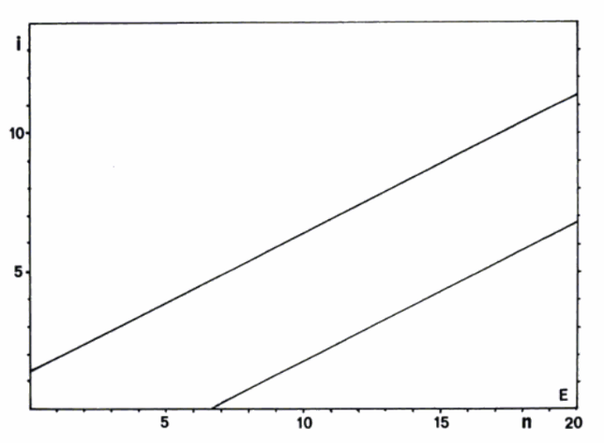
Fixed-precision sequential sampling plans:
Supervised Control of Brussels sprouts pests
Threshold: 10% plants infested
Threshold: 50% plants infested
Accumulated number of infested plants
Treat
Treat
No decision
No decision
Don’t treat
Don’t treat
Accumulated number of plants sampled
NB: You can’t eliminate mistakes entirely: Type I error: False positive; Type II error: False negative

Slide 9
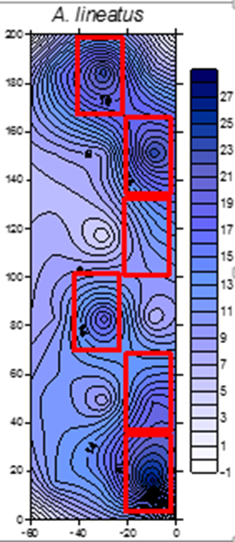
..and the ‘where’ - spatial distribution?
How are the pests distributed and does this change with time?
  Aggregated/random?
  Edge effects?
Taylor’s Power Law
SADIE
Other geostats

Slide 10
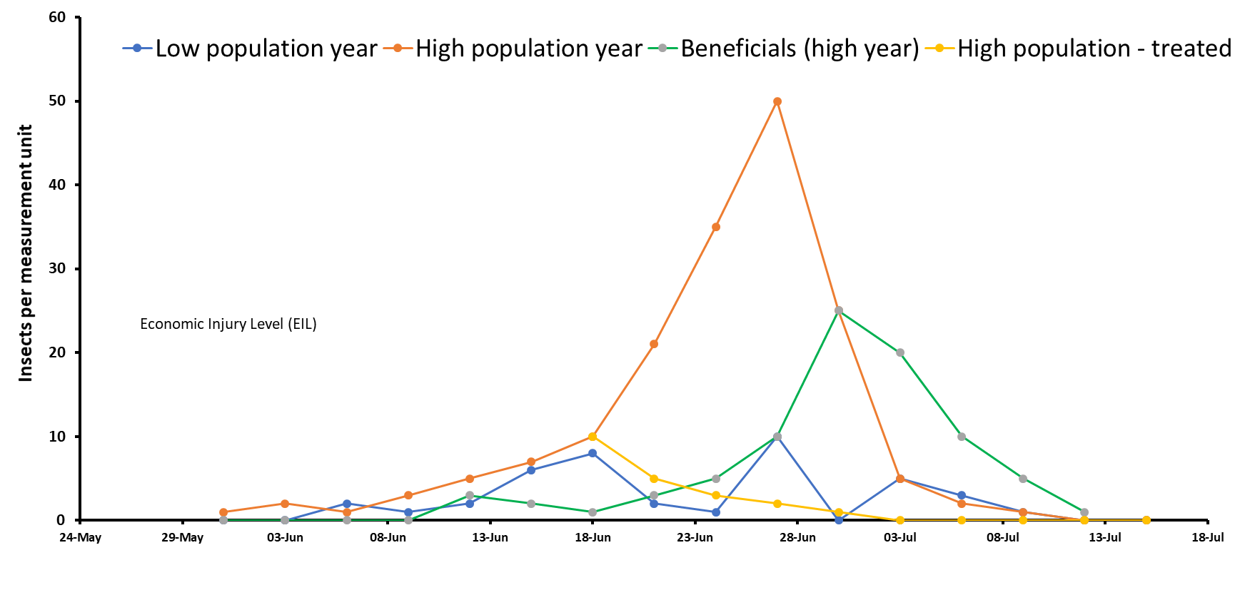

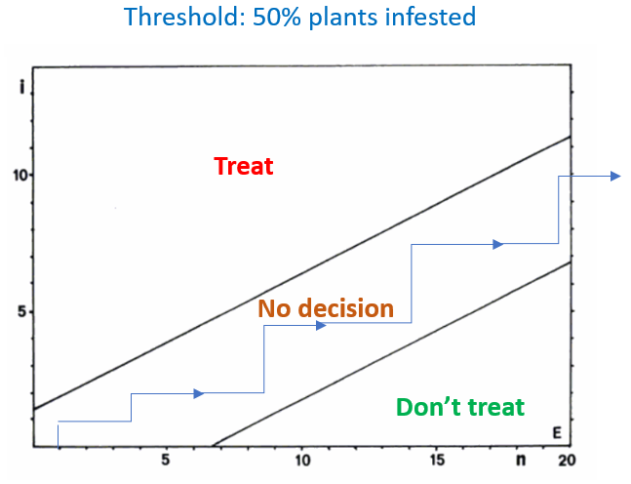
Thresholds – a complex & risky business
Are thresholds always appropriate?
  Yield vs quality?
  Crop survival vs acceptable/recoverable damage
  Virus transmission vs direct damage
Do we know what we are looking for and why?
  Eggs, larvae, adults?
  Economic damage vs population level relationship (ET/EIL)
  Crop compensation effects?
Do we know when to look for it?
  Pre-cropping, in the crop (growth stage?) or post-crop?
Do we know where to look for it?
  On the plant, in the soil, in the air?
  Which part of the field?
Do we know how best to look/assess?
  What are the practicalities & economics of sampling and do they stack up?
Do we understand the risks & trade-offs?
  What else is affected by controlling this pest (in this way)
  Effects on beneficials
  Cost:benefit analysis

Slide 11
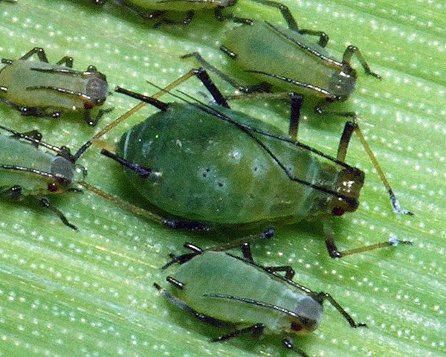
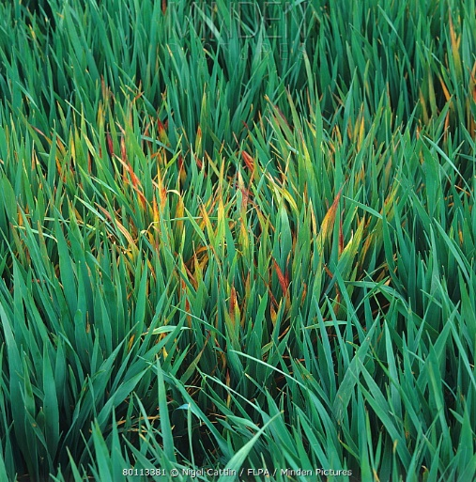
Yield loss caused by cereal aphids
The ‘accepted’ wisdom – a simple action threshold:
  5 aphids/ear at flowering (GS 61) and increasing (Ken George, 1975/1979).
  Subsequently adjusted to 66% tillers infested.
  Thought to cause around 20% yield loss….
  Any relevance to today’s wheat varieties?
Was/is this good enough?
  Large differences between potential and achieved profits
  Value of insecticide treatment varies with time course of infestation
  Value of forecast depends on its timing & accuracy, the size of the aphid outbreak & its probability of occurrence.
  …and BYDV?
  Watt, A D, Vickerman, G P & Wratten, S D (1984). The effect of the grain aphid, Sitobion avenae, on winter wheat in England: an analysis of the economics of control practice and forecasting systems. Crop Protection 3 209-222.

Slide 12
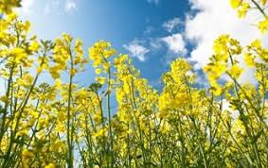
Yield loss caused by cabbage stem flea beetle
The accepted wisdom – a simple action threshold:
  NB – there is/was a model for predicting egg hatch
  3-5 larvae plant in the late autumn – plant dissection
  Subsequently adjusted to a measure of petiole scarring - visual
  Any relevance to today?
Larval damage? We should be so lucky!
  NIAB/TAG Survey: 13% crop failure in 2018, 29% in 2019.
  The timing of adult invasion varies considerably from year to year, being influenced mainly by temperature.
  Early-germinating crops tend to be invaded earlier than later-germinating ones.
Alford, D V 1979. Observations on the cabbage stem flea beetle, Psylliodes chrysocephala, on winter oilseed rape in Cambridgeshire. Annals of Applied Biology 93: 117-123

Slide 13
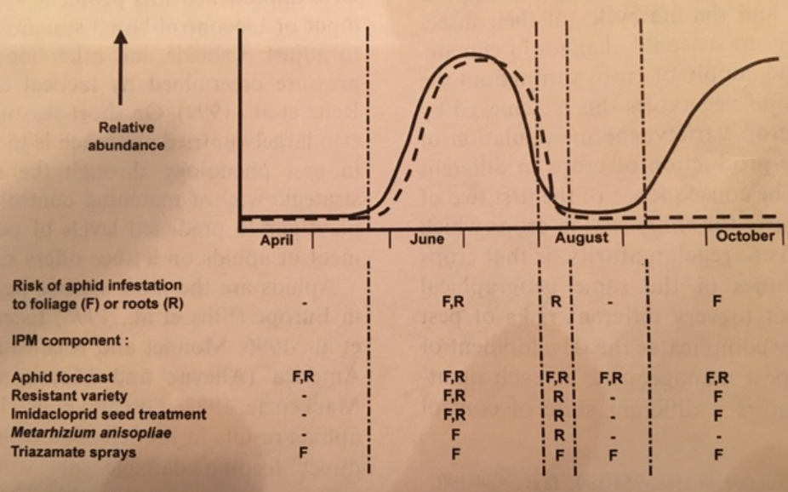
Currant-lettuce aphid & Lettuce root aphid
Quality & yield….but zero tolerance of contamination
Aphid risk varies through the year
  Different plantings have different risk levels
  Different control measures could be applied based on risk
Forecasting more important than thresholds
Parker, W. E., Collier, R. H., Ellis, P. R., Mead, A., Chandler, D., Blood Smyth, J. A., Tatchell, G. M. (2002). Matching control options to a pest complex: the integrated pest management of aphids in sequentially-planted crops of outdoor lettuce. Crop Protection 21 pp 235-248.

Slide 14
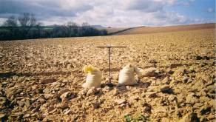
Soil sampling for wireworms (on potato)
Developed in 1940s
  OK for high populations
  Very unreliable for low populations
There is a lot of soil out there!
  Big sampling issue
  Ideally needs lab processing
Reality check!
  Poor correlation between what you find and subsequent damage levels
Risks
  You can miss damaging populations
  There is no in-crop control
  Risk assessment requires everything we’ve got

Slide 15
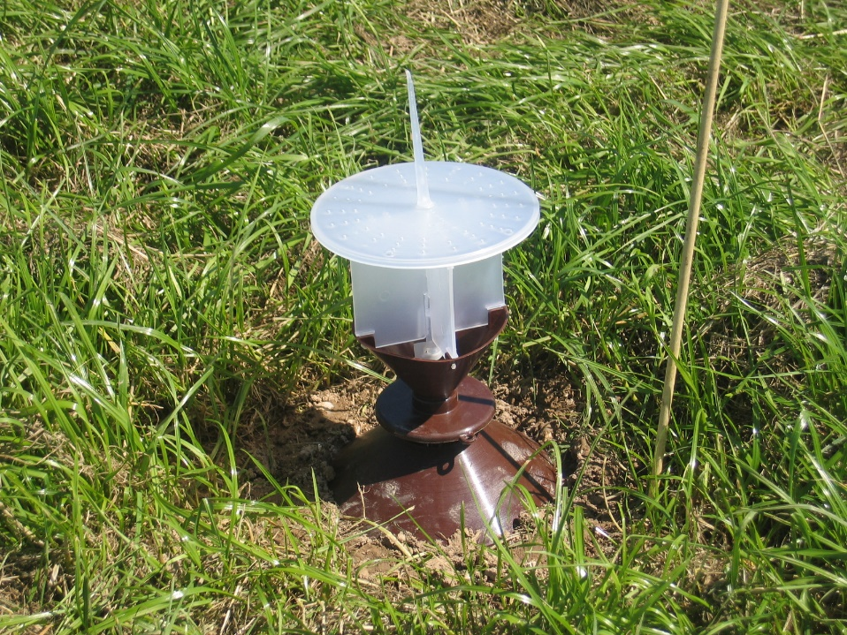
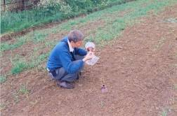
Seasonal click beetle pheromone catch profile
Llanafan (2000)
Season-long trapping is NOT the best way of doing it
Parker, W E & Howard, J J 2001. The biology and management of wireworms (Agriotes spp.) on potato with particular reference to the United Kingdom. Agricultural & Forest Entomology 3 pp 85-98.

Slide 16
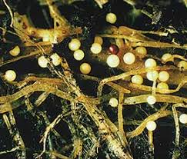
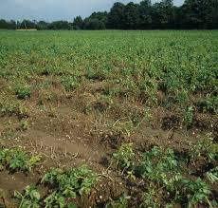
Potato cyst nematodes – timescale, tactics & strategy!

Slide 17
Thresholds – so what have we learned?
Are thresholds always appropriate?
  Yield vs quality?
  Crop survival vs acceptable/recoverable damage
  Virus transmission vs direct damage
Do we know what we are looking for and why?
  Eggs, larvae, adults?
  Economic damage vs population level relationship (ET/EIL)
Do we know when to look for it?
  Growth stage?
  Pre-cropping, in the crop or post-crop?
Do we know where to look for it?
  On the plant, in the soil, in the air?
  Which part of the field?
Do we know how best to look/assess?
  What are the practicalities & economics of sampling and do they stack up?
Do we understand the risks & trade-offs?
  What else is affected by controlling this pest (in this way)
  Effects on beneficials?
No: depends on the type of pest/crop relationship, what level of control is required etc etc.
Yes - but: practicalities may mean that you need to measure a ‘proxy’; hard to figure out the ET/EIL.
Yes: but could be improved a lot for some pest/crop combinations
Depends: on the plant – generally yes. In the field – sometimes not obvious, particularly soil pests.
No: much work done on sampling strategies but remain a fundamental practical stumbling block.
Up to a point: this is the ‘I’ in IPM but the complete integration of pest, disease and weed control requires much more attention.

Slide 18
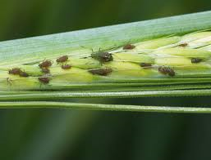
So do we have decent thresholds for UK arable pests?
1986: Internal review by ADAS Entomology
  Most thresholds either have no published scientific evidence to support them or are based on old, unpublished data.
2017 (30 years on): Ramsden et al., (2017)
  Most current economic thresholds for pests of arable crops are not based on published evidence.
  Few account for the ability of crops to tolerate pest damage, or the amount, or type of crop damage that pests can cause.
  Many of the methods of pest assessment are impractical and do not guarantee sufficiently accurate estimates of pest abundance.
  Ramsden, M, Kendall, S, Ellis, SA, Berry, PM 2017. A review of economic thresholds for invertebrate pests in UK arable crops. Crop Protection 96: 30-43

Slide 19

Realities
Control of foliar insect pests on major arable crops has been too cheap to justify the use of thresholds as a decision-making tool.
  A low-risk approach has been widespread though not universal
  The consequences have been serious – but have taken time to show.
Soil pests are a somewhat different story, but problems remain
  The higher cost of control has justified more focus on risk assessment.
Sampling time/cost has been (and probably remains) the biggest single barrier.
  The practicality/accuracy of traditional sampling methods has not been good enough.
Developing robust, dynamic thresholds that reflect a genuine cost:benefit analysis is difficult and complex.
  This has been under-researched and under-funded over many years – but largely because the pests were (until recently) easily & cheaply controlled.

Slide 20
Risk: how much would you take?
No risk – theoretical!
Risk ‘appetite’ will vary with:
Crop type – yield or quality
Likely value of crop
Perceptions of farmer/grower
Perceptions of agronomist
‘Efficacy or otherwise of control options
The extent to which controls are curative
Everyone will be different
How do we mitigate the risk?
Once you pass here you’ve lost it
Incremental but not catastrophic

Slide 21


So where is the future?
GROWER OWNED & GOVERNED
GiSC is the only grower-owned and governed data cooperative that encourages better management decisions. By aggregating and analyzing data, growers are able to utilize their data to gain business insights through our partnerships with experienced technology companies that have game-changing tools.
Need to take what we have learned
  But apply it differently
Judging risk is a combination of experience and data
  On-farm ‘experience’ needs to be measured, pooled and analysed
  ‘Big data’ analytics will be required
Data, data everywhere but what is really useful?
  Where are we data poor where being data rich would enable a better decision/risk calculation?
Farmers, growers & agronomists must have confidence
  Data sharing is the way forward but issues of ownership, trust and commercial sensitivity need to be resolved.
  Who does the analysis?

Slide 22
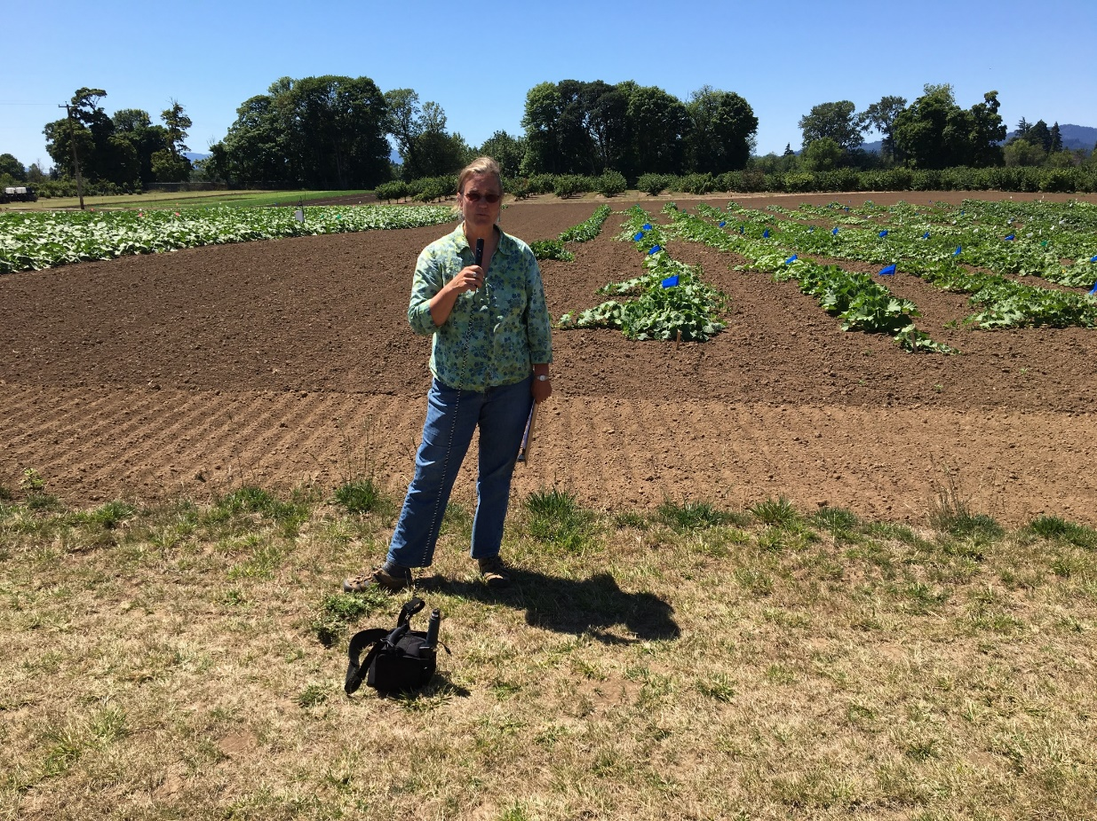
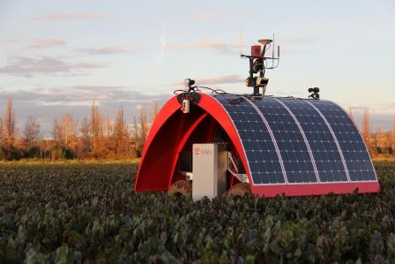
Another lesson from history?
Implementation of almost everything in commercial growing depends on cooperation between the researcher, the agronomist and the progressive farmer/grower.
The researcher must respect the risks taken by the agronomist –– the agronomist carries the risk of failure after all.
New methods must be technically sound and feasible for the farmer/grower i.e. as simple and short as possible. Possibly less critical if benefits are large.
Cost:benefit analysis is required
Growers/Farmers will be increasingly seen as ‘progressive’ if they reduce pesticide use
J Theunissen & H van Ouden, 1985. Progress on Pest Management in Field Vegetables. Edited by R. Cavallo.

